Slide 1


HEALTH-A-PLENTY
LordGeeks

Slide 2
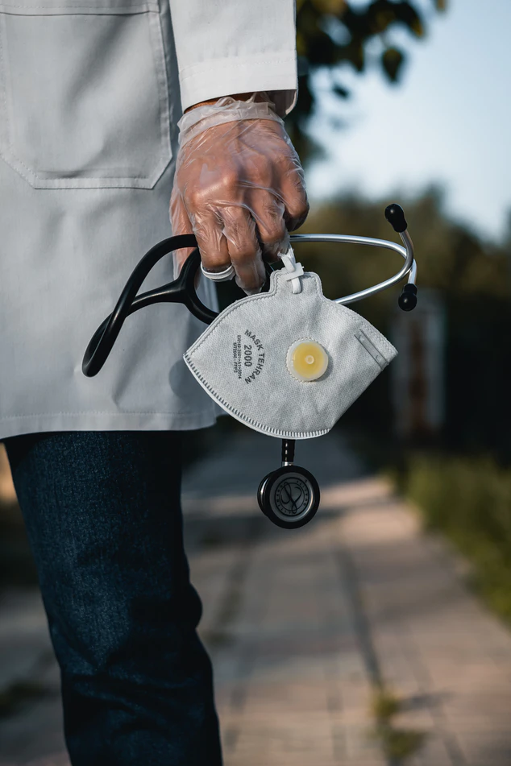
Problem Statement
As we look into the current scenario of the modern world, it's clearly visible that people are comparitively falling ill and though the death ratio is comparitively decreasing but still at a very low rate compared to what it can be. The one main reason of this is the lack of proper knowledge and a regularity check on your health.
What we do is with the help of our website you can check your medical status to ensure that you are completely safe or may require a doctor for your current health status. Due to unavailability of proper resources we still have access to only some of the major diseases like some heart disease, liver disease, malaria, pneumonia, breast cancer and the most common one diabetes.

Slide 3


Online Medical Diagnostics
Health-A-Plenty offers you a platform where you can diagnose
your health easily

Slide 4
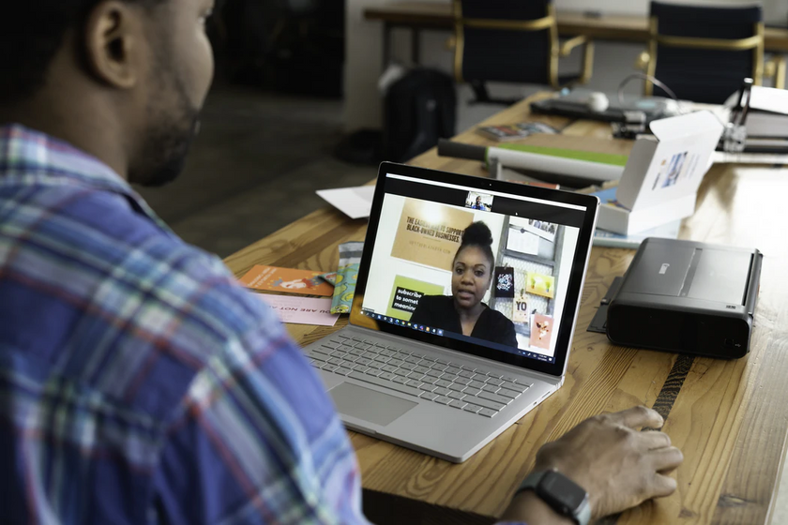


SERVICES
Following are the services we provide in our platform.

Slide 5


COVID Tracker
Check your covid status with symptoms. Also, we provide a current COVID status map that informs about the world-wide scenario of the very pandemic.
Nearby Hospitals and Pharmacies
Find nearby hospitals and pharmacies to your home with authentic locations in a map-view for medical emergencies.

Slide 6
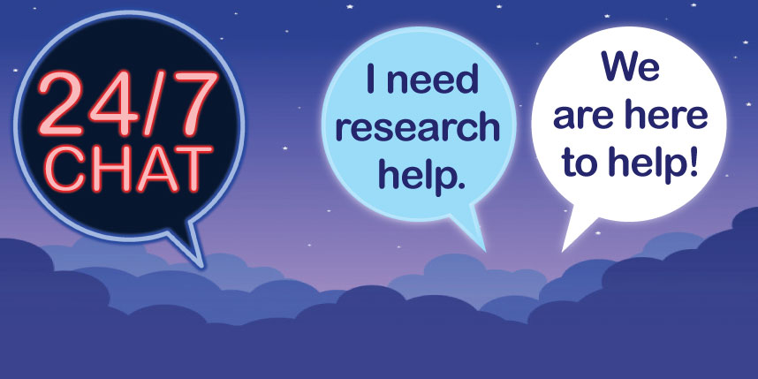

Chat Section
Chat with our team directly. Also we have a community chat where patients may share information among each others.
Appointment Section
Book an appointment for you and your loved ones from anywhere, anytime.

Slide 7

First- Aid Section
Here you can get all the useful informations ,symptoms, precautions and
emergency measures to be taken in deadly diseases like Malaria, Pneumonia, Breast-cancer and many more.

Slide 8
Breast Cancer
What you can diagnose with our website
Heart Disease
Liver Disease
Maleria
Pneumonia
Diabetes

Slide 9
Target Market
People who can't visit to hospitals
Aged People
Handicapped
People who are aged and cannot visit to hospitals.
Physically disabled people who can't reach out to hospitals or dispensaries.

Slide 10

Business Model

Slide 11
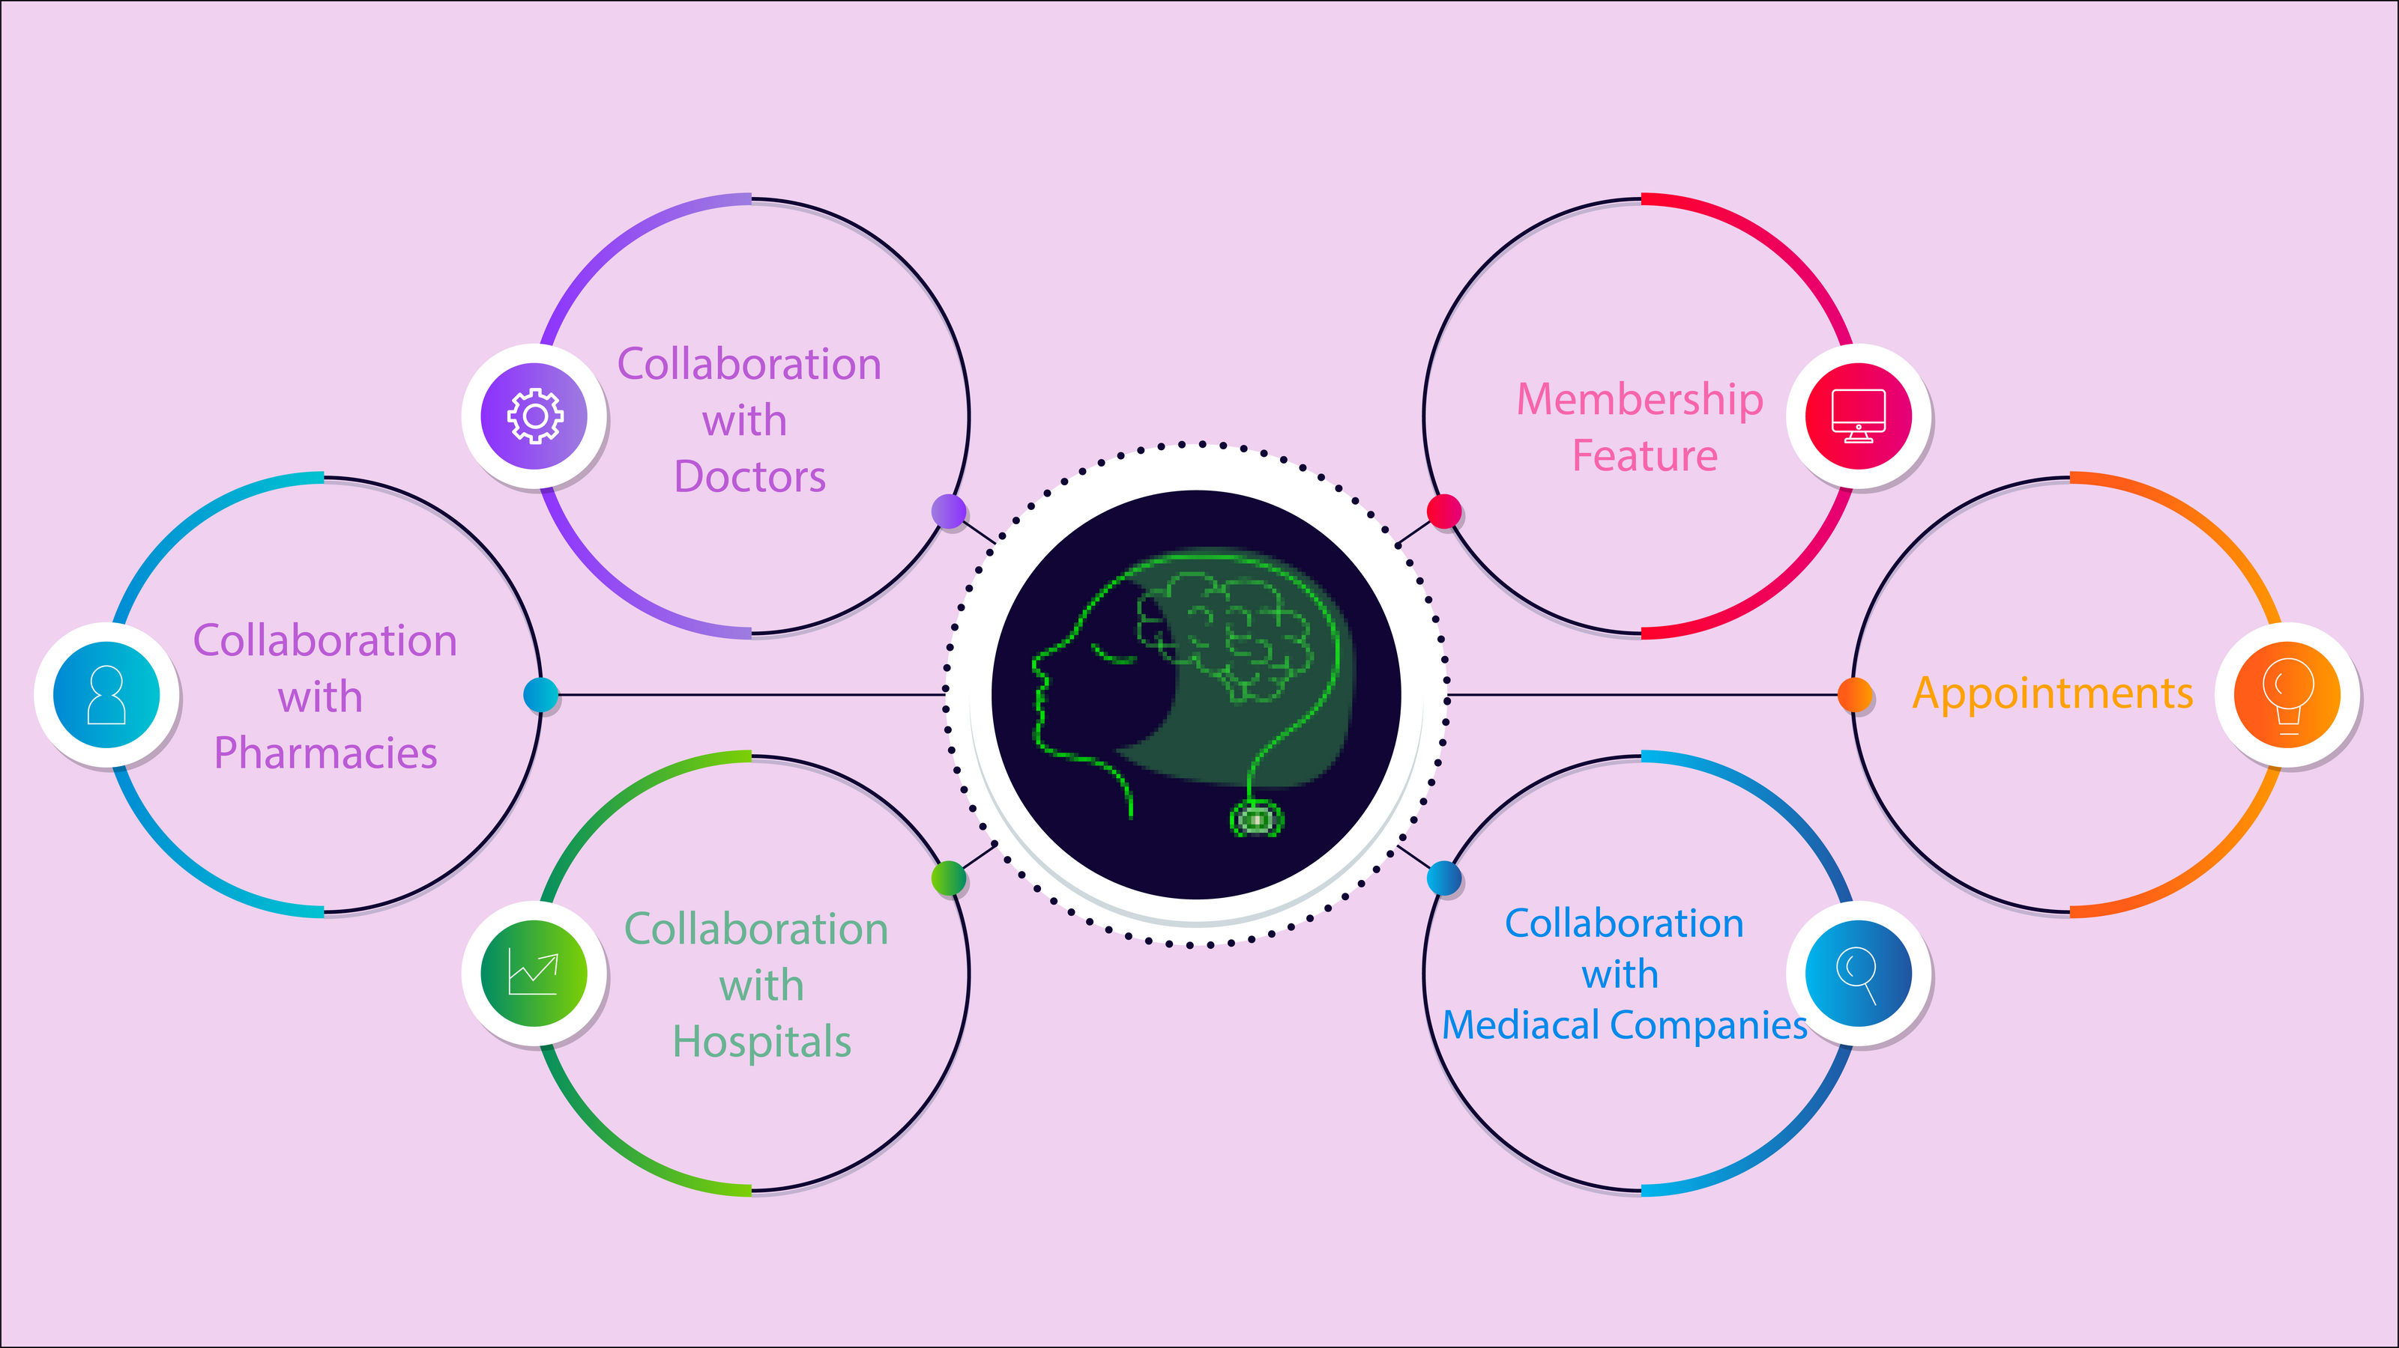

Slide 12
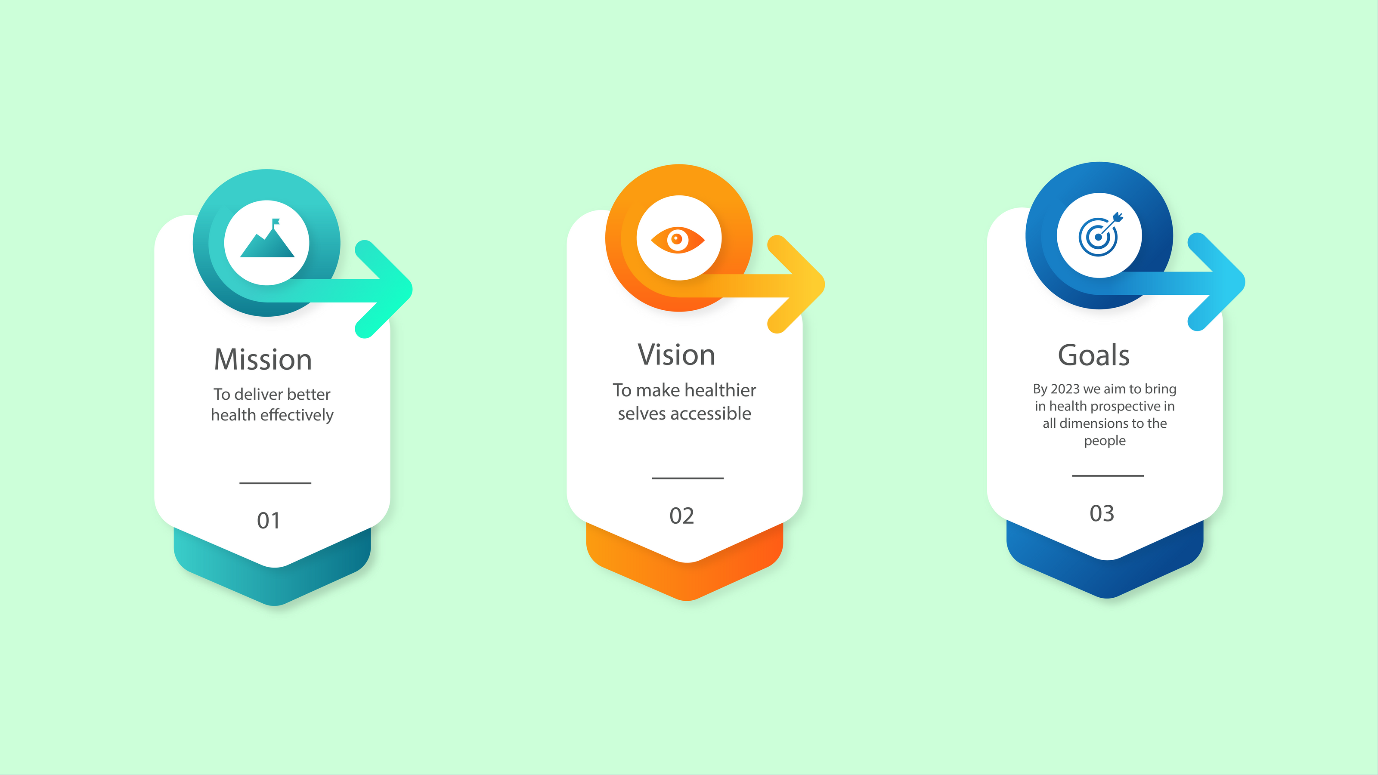

Slide 13









Tech Stack:
Node JS
Jquery
BootStrap
Firebase Authentication
Firebase Database
WebRTC
Python, Flask
Tensorflow, OpenCV

Slide 14



THANK YOU

